Slide 1
Liver Disease Predictor
Should you visit a doctor? Let’s find out
** This tool is intended for informational purposes only and should not be used as a definitive decision-maker or substitute for professional medical advice.

Slide 2
1 out of 25
11th
1,000’000’s
Why?
Deaths are attributed to liver disease
Most common cause of death globally
Of people affected each year
Source: https://doi.org/10.1016/j.jhep.2023.03.017.

Slide 3

Our solution
We developed a Liver Disease Predictor based on a Machine Learning model using real patients data.
The tool uses key health factors to estimate the likelihood of liver disease with 91% accuracy.
It provides a quick and accessible evaluation for users.

Slide 4
PROCESS PIPELINE
01
02
03
04
ETL
(Extract, Transform and Load)
Data Visualization
Linear Correlation Dismissal
ML Models Training
05
06
07
08
Models Evaluation
Back-End
Development
Front-End Design
Testing

Slide 5
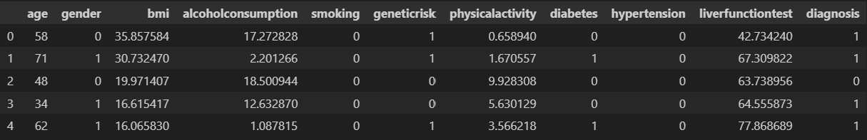
ETL
Pandas

Slide 6
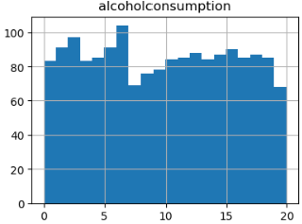
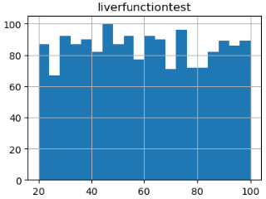
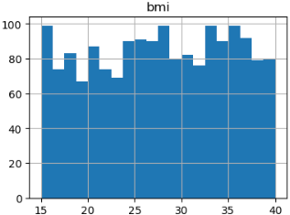
Data Visualization
Matplotlib

Slide 7
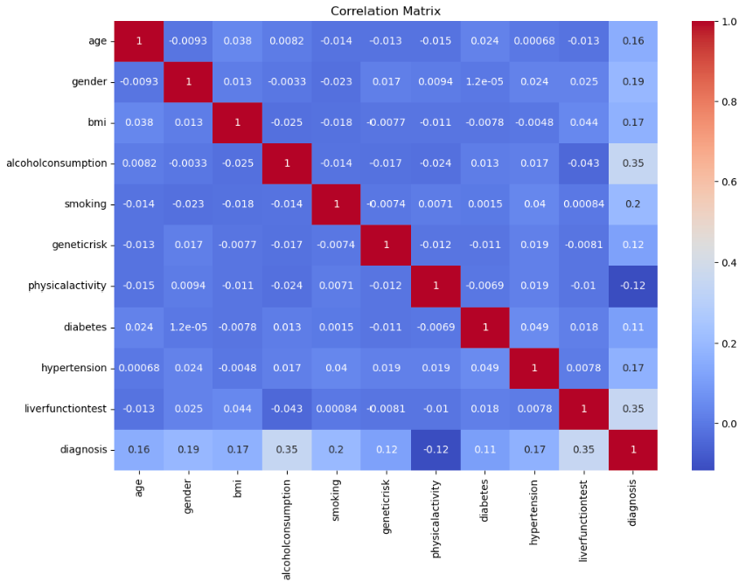
Linear Correlation Dismissal
Seaborn

Slide 8
ML Models Training (binary classification)
XGBoost
Sequential (with keras optimization)
Neural network with custom layers. Flexible and powerful.
Scalable gradient boosting. High accuracy and robustness.
LightGBM
Random Forest
Tree-based gradient boosting. Fast and memory-efficient.
Ensemble of decision trees. Robust to overfitting, good generalization.

Slide 9
Models Evaluation
Sequential | 83% accuracy
XGBoost | 89% accuracy
LightGBM | 91% accuracy
Random Forest | 89% accuracy

Slide 10




Back-end Development
Flask
Joblib
SQLAlchemy
Numpy

Slide 11





Front-End Design
HTML
CSS
BootStrap
JavaScript
JQuery

Slide 12
TESTING

